Slide 1

LECTURE-6
MISS AQSA FAYYAZ
LECTURER- PSYCHOLOGY
SCIENCE AND HUMANITIES

Slide 2


LEARNING OUTCOMES
Understanding the definition and nature of Motivation.
Types of motivation
Theories of motivation
Tips for finding motivation

Slide 3

MOTIVATION
Many people know motivation as a driving force /Reasoning behind an action.
The term ‘motivation’ is derived from the word ‘motive ’.
Motive may be defined as needs, wants, drives within the individual

Slide 4
A motivation is a condition that energizes behavior and gives it direction.
Motivation is the process that initiates, guides, and maintains goal-oriented behaviors. It is what causes you to act, whether it is getting a glass of water (goal) to reduce thirst (drive) or reading a book to gain knowledge.

Slide 5
NATURE OF MOTIVATION
Based on motives
Goal directed behavior
Related to satisfaction

Slide 6
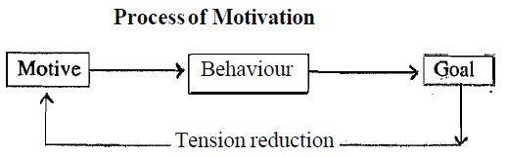

Slide 7

TYPES OF MOTIVATION
Extrinsic motivations is reward-driven behavior. A desire to perform a behavior to obtain an external reward or avoid punishment
Examples are:
competing in sports for trophies.
completing work for money.
customer loyalty discounts.
buy one, get one free sales.
Helping other because you hope for praise.

Slide 8
2. Intrinsic motivations: are those that arise from within the individual OR
A desire to perform a behavior originates within the individual
For example:
Doing a complicated cross-word puzzle purely for the personal gratification of solving a problem.
Learning new language because you like experiencing new things.
Taking on more responsibility at work because you enjoy being challenged & feeling accomplished.

Slide 9
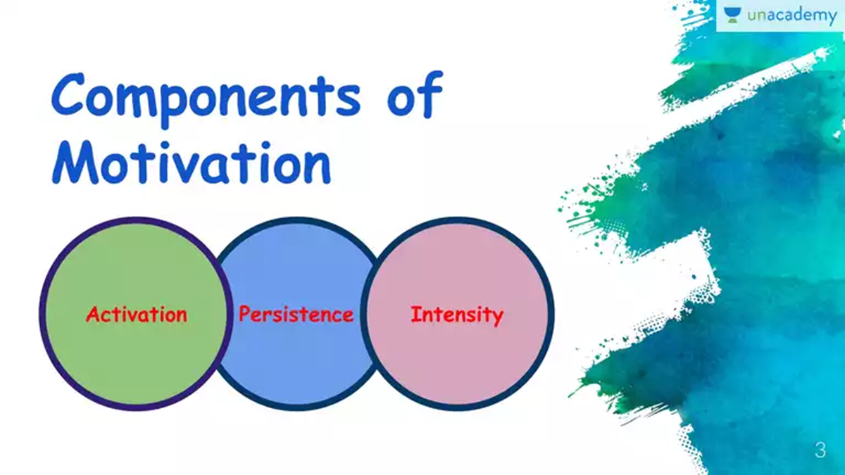

Slide 10
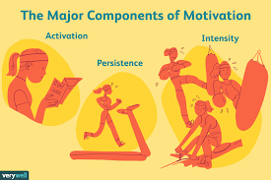
Arnold et al (1991)
1. Activation: involves the decision to initiate a behavior
2. Persistence is the continued effort toward a goal even though obstacles may exist.
3. Intensity can be seen in the concentration that goes into pursuing a goal. It describes how hard a person tries. This is the element most of us focus on when we talk about motivation.

Slide 11
1. Activation آغاز such as enrolling in a psychology class.
2. Persistence مسلسل An example of persistence would be taking more psychology courses in order to earn a degree although it requires a significant investment of time, energy and resources.
3. Intensityشدت For example, one student might not put much efforts, while another student will study regularly, participate in discussions and take advantage of research opportunities outside of class.
The first student lacks intensity, while the second pursues his educational goals with much greater intensity.

Slide 12
THEORIES OF MOTIVATION
Drive Reduction Theories
Humanistic theories

Slide 13
DRIVE REDUCTION THEORY
Developed by Clark L. Hull, the Drive-Reduction Theory states that According to the theory, the reduction of drives is the primary force behind motivation.
when an organism has a need (such as hunger), the need leads to psychological tension that motivates the organism to act, fulfilling the needs and reducing the tension.
Example:
When we're cold, we put on a sweater to address our need for warmth and maintain our body temperature.

Slide 14
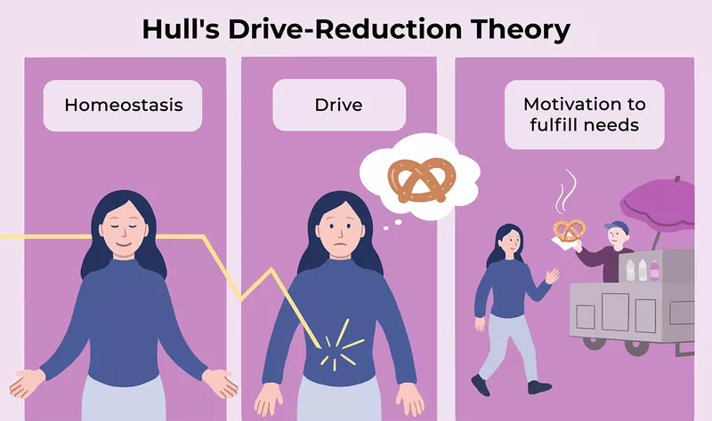

Slide 15
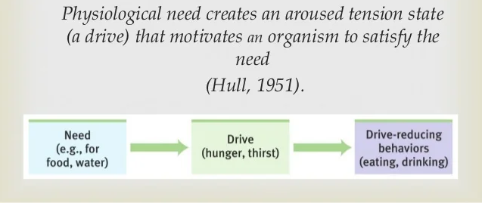

Slide 16
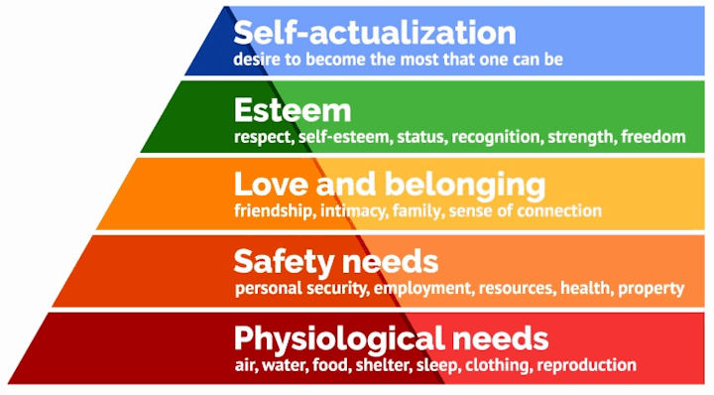
Humanistic Theory –
Maslow’s Hierarchy
Maslow’s model places motivational needs in a hierarchy and suggests that before more sophisticated, higher-order needs can be met, certain primary needs must be satisfied

Slide 17
The basic needs are primary drives: needs for water, food, sleep, sex, and the like.
To move up the hierarchy, a person must first meet these basic physiological needs. Safety needs come next in the hierarchy; Maslow suggests that people need a safe, secure environment in order to function effectively. Physiological and safety needs compose the lower-order needs.
Only after meeting the basic lower-order needs can a person consider fulfilling Higher order needs, such as the needs for love and a sense of belonging, esteem, and self-actualization. Love and belongingness needs include the needs to obtain and give affection and to be a contributing member of some group or society. After fulfilling these needs, a person strives for esteem.

Slide 18
In Maslow’s thinking, esteem relates to the need to develop a sense of self-worth by recognizing that others know and value one’s competence.
Once these four sets of needs are fulfilled—no easy task—a person is able to strive for the highest-level need, self-actualization.
Self-actualization is a state of self-fulfillment in
which people realize their highest potentials in their
own unique way.

Slide 19
FOR EXAMS

Slide 20

Tips For Finding Motivation
Adjust your goals to focus on things that really matter to you
If you're tackling something that is just too big or too overwhelming, break it up into smaller steps and try setting your sights on achieving that first step toward progress
Remind yourself about what you achieved in the past and what/ where your strengths lie
If there are things you feel insecure about, try working on making improvements in those areas so that you feel more skilled and capable.

